Slide 1
Age Related Memory Loss &
How to Improve Memory
What is memory
How we remember
Age related memory loss
Causes of memory impairment
How to prevent memory loss
How to improve memory
Alzheimer’s Disease
NATEA Seminar
March 27, 2010 Kim W. Yang

Slide 2
DISCLAIMER
The information I am giving to you today is intended for general reference purposes only. It is not a substitute for professional medical advice or a medical exam. Always seek the advice of your physician or other qualified health professional before starting any new activity or life style change. Medical information changes rapidly and while I make efforts to update the content in my speech, some information may be out of date.
Kim W. Yang

Slide 3
What is Memory?
All that you remember, Information Retaining.
Your Capacity for Remembering
Your mind works a lot like a computer. Your brain puts information it judges to be important into "files." When you remember something, you pull up a file. Memory doesn't always work perfectly. As people grow older, it may take longer to retrieve those files.
It's normal to forget things once in a while. We've all forgotten a name, where we put our keys, or if we locked the front door. But forgetting how to use the telephone or find your way home may be signs of a more serious problem

Slide 4
Short Term and Long Term Memory
Sensory Memory, lasts 300 millisecond, Visual & Auditory, unlimited capacity
Short Term Memory
(1) Working Memory
(2) Fleeting and Limited (7 + 2 bytes)
(3) Fragile & Decaying
Long Term Memory
(1) Emotionally Compelling
(2) Personally Meaningful
(3) Virtually Unlimited

Slide 5
Long Term Memory
Categories
Declarative or Explicit Memory:
Semantic & Factual Knowledge, not bound to specific point of time
Episodic, tied to specific time & place
Non-declarative or Implicit Memory:
Procedural Memory, Skill, Routines

Slide 6
Long Term Memory
Some long term memory will become irrelevant, distorted, fade over time, some won’t fade over time.
Barring disease or injury to the brain, one can always learn and retain something new.
Human brain has 100 billion neurons, each neuron could make 5,000 to 10,000 synaptic connections. We have 500 to 1,000 trillion synaptic connections. Some estimates 10¹⁰ to 10¹³ bytes
Library of US Congress has 32 trillion bytes.

Slide 7
How We Remember?
Stage one: Acquisition
Stage two: Consolidation
Consolidation of Declarative Memory
Consolidation of Procedural Memory
Stage three: Retrieval

Slide 8
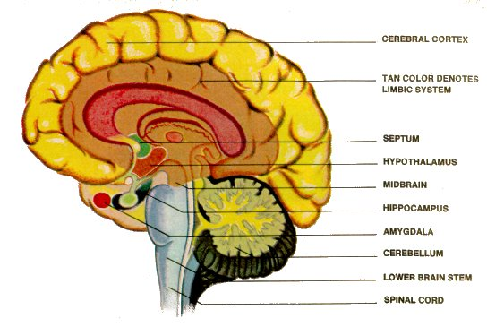
Human Brain

Slide 9
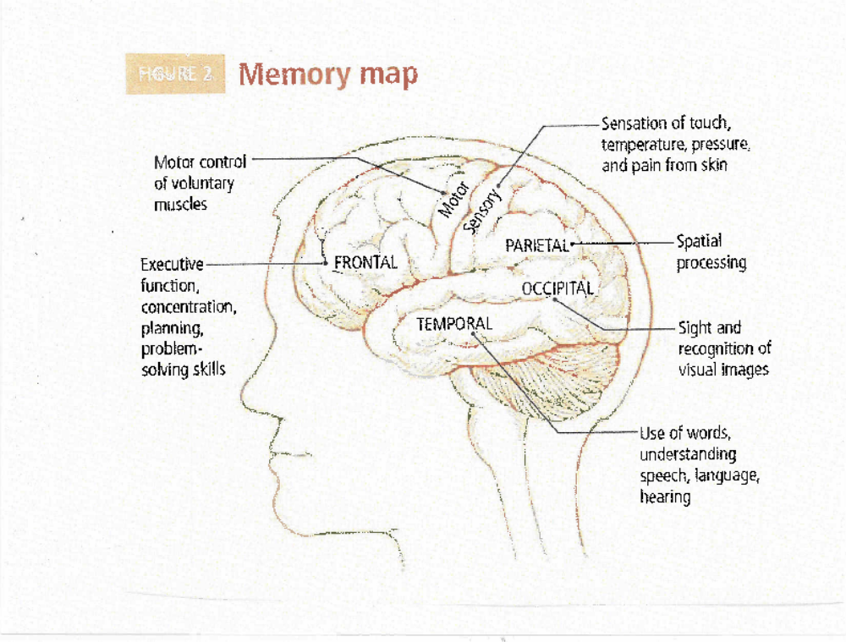
Human Memory Map

Slide 10
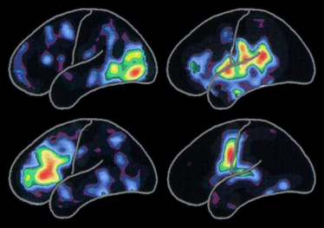
Reading Hearing
Thinking Saying, Singing

Slide 11
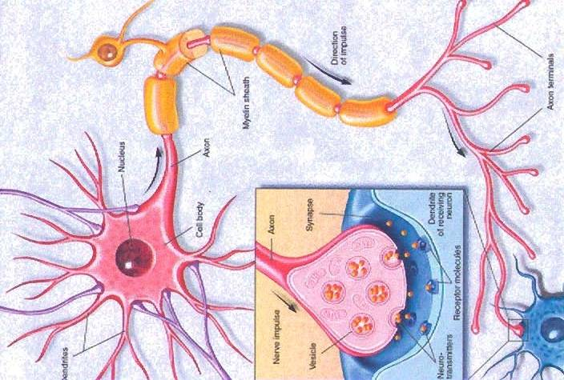
Synaptic Junction

Slide 12
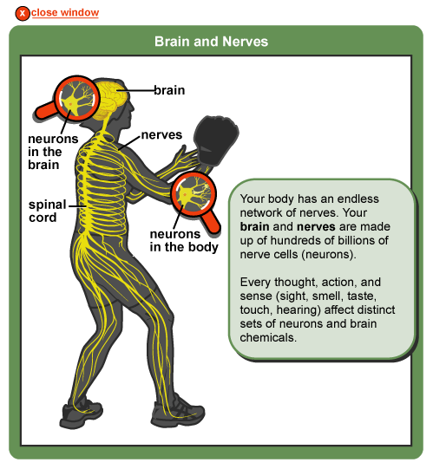
Brain and Nerves

Slide 13
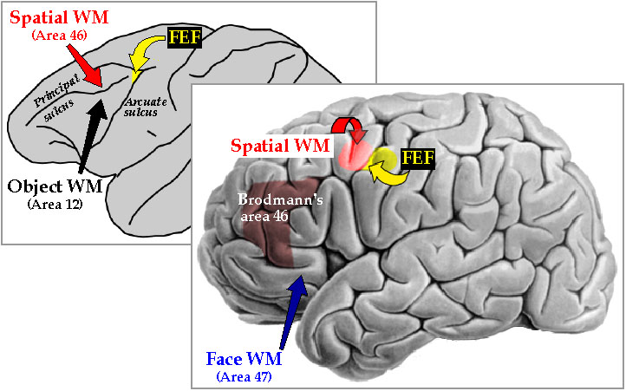
Monkey (L) and Human (R) Spatial Working Memory: moved upward & Rearward to serve more distinctly human functions through evolution

Slide 14
How Memory Changes With Age?
Procedural Memory always OK
Declarative memory fades with age, this type of memory depends on hippocampus
Learn more slowly and retrieve more slowly, more trouble recalling
Will power and effort can overcome this type of memory loss
Scientist used to think 10,000 brain cells (neuron) die every day when we age and could not re-grow. New evidences indicate our brains do grow new cells, especially if we keep using our brain

Slide 15
How Memory Changes With Age?
(Continued)
Neuro transmitters such as dopamine, acetyl-choline. Serotonine, etc. reduced
Harder to remember, harder to learn
Would not impair our ability to remember:
1. We are able to make more reasonable arguments
2. We are able to make correct judgment
3. Our wisdom gained from experiences remain unscathed

Slide 16
Normal Forgetting & Dementia
Seven types of Normal Forgetting:
1. Transience
2. Absentmindedness
3. Blocking (ugly stepsisters)
4. Misattribution
5. Suggestibility
6. Bias
7. Persistence
Dementia: Progressive deterioration, extreme & debilitating, usually damage to the hippocampus & related structure in the brain

Slide 17
Mild Cognitive Impairment
Not necessary sign of Alzheimer’s disease (81% didn’t develop to Alzheimer’s Disease (AD))
Causes:
1. Neurological disorder
Alzheimer Disease, Cerebrovascular Diseases & Stroke,
Head Trauma, Infectious disease to brain
2. Genes
3. Hormones
4. Vitamin (B₁₂) deficiency

Slide 18
Mild Cognitive Impairment
(Causes Continued)
Cardiovascular Disease & its Risk Factors:
Hypertension, High Cholesterol, Diabetes, Coronary artery
bypass surgery
6. Depression
7. Post Traumatic Stress Disorder
8. Thyroid dysfunction
9. Hearing Loss
10. Sleep Disorders
11. Medication
12. Lifestyle Factors:
Alcohol,diet,lack of intellectual stimulations, sedentary life, lack of sleep, stress, smoking, illicit drugs, toxic exposure

Slide 19
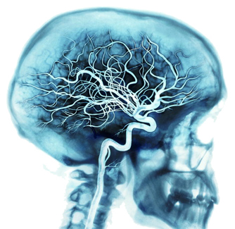
Blood Supply to Human Brain

Slide 20
How to Prevent Memory Loss
Exercise
Keep learning
Don’t smoke
Drink alcohol in moderation
Healthy diet
Vitamins: Multivitamins, C,D,E,B₆,B₁₂, Folic Acid, Fish Oil, Olive Oil
Good night sleep
Friends
Manage stress
Protect your head and brain, don’t get concussion

Slide 21
How to improve memory
Get organized (belongings, appointments, tasks, contacts, vital information, locations, checklists)
Get Focus
Repeat
Ensure comprehension
Make note
Be patient
Spaced rehearsal
Professional memory training
Do small tasks first

Slide 22
Alzheimer’s Disease
What it is?
Signs & Symptoms
Causes, Risks & Prevention
Drug Treatments & Care

Slide 23
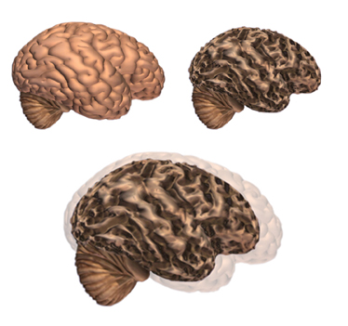
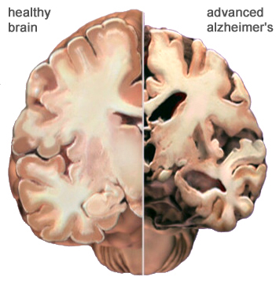
Normal and Advance AD Brains

Slide 24
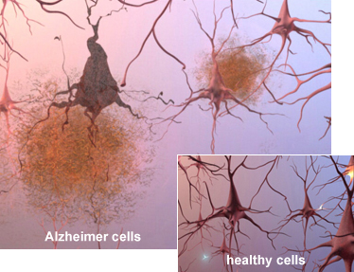
Under The Microscope

Slide 25
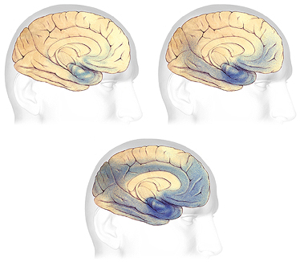
Progression Through the Brain

Slide 26
New Hopes
Adult animals and human do grow new brain cells (neurons)
New Medications:
Ampakines, secretase inhibiters, huperzine A alithium-like drugs, alzhemed, vaccine, NSAIDs (Ibuprofen, naproxen, celecoxib, etc.
Stem-cell Transplants
Gene Therapy

Slide 27

Thank you all

Slide 28
Dementia Summary
Alzheimer’s Disease (AD)
Mild Cognitive Impairment (MCI)
Vascular Dementia
Mixed Dementia (AD Plus)
Dementia With Lewy Bodies
Parkinson’s Disease
Frontotemporal Dementia
Creutzfeldt-Jakob Disease
Huntington’s Disease
Wernicke-Korsakoff Syndrome
Normal Pressure Hydrocephalus

